Slide 1
Duplicate these slides for your class
Review teacher notes.
Edit homework/announcements slide accordingly.
Update the Session Agenda
Starter Code
Example Project
Example Repo
Question adder
How To: Visual Studio Code
database
Review: Project Outline, Presentation Specifications, Pitch Guidelines

Slide 2
In this unit, coders will work in groups to build a project using HTML, CSS, REACT, and Firebase. Their task is to build out the front-end for a Kahoot style question game that displays a question and the possible answers, allows a user to choose answer and determine whether they are right or wrong. This project is intended to highlight some important aspects of goal setting and project management. The project will culminate in a final presentation.

Slide 3
Students need to take a look at the goal layout
Discuss how they would break it down into components & child components
Pass props from parent to children
Pass functions from parent to children
Prop Drilling! Trivia Game Component > Question Component > Answer Component

Slide 4
Open your Session Agenda
Sign in to Slack
Add questions using the question adder
Opening Planning Doc
Complete 3.3 Do Now in Repl.it

Slide 5
Unit 3: Session 3

Slide 6
Use multiple components to create a complex layout
Vocabulary: Prop Drilling, Composition
Notes:
Teacher Notes:
Coders should read aloud the objective.

Slide 7
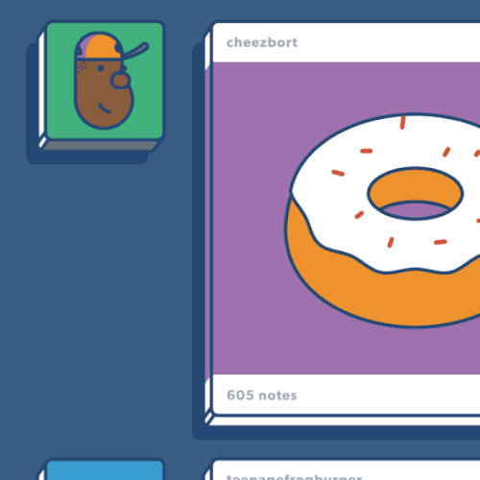
Complex Layouts
All around the world, Engineers like you and me use multiple components to create complex layouts.
Let’s review some of the terms we’ve been using in class as we built the components we’ve made so far!
Notes:
Teacher Notes:
Its is very important you are explicit with Homework expectations. Homework is mandatory and we will be tracking your completion throughout the year. Be clear on the timeline when homework should be submitted.

Slide 8
Review: JSX
JSX is the tag syntax used for creating React Components.
It’s like HTML with the added ability to use any valid JavaScript expression inside curly braces.
let name = 'Edgar Muentes';
let Header = <h1>Hello, {name}</h1>;

Slide 9
Review: Component Declaration
Component Declaration The code that defines your component. This component is defined in one place and each time we use the component it’s running this code.
1 2 3 4 5 6
let Header = (props) => ( <h1>Hello, {props.name}</h1>; );

Slide 10
Review: State
1 2 3 4 5 6 7 8 9 10 11 12
13
function Example() {
const [ orangeState, setOrangeState ] = useState(‘unsliced’);
return (
<button onClick={() =>
setOrangeState(‘sliced’)
}>
Click to peel the orange. The orange is {orangeState}
</button>
);
}
state updating function
State
A JavaScript variable that we store in the component & update to manage its state
Initial State
React hook called ‘useState’
updated state
Updating State
Accessing State
initial state
Notes:
Adjust for your class as needed

Slide 11
Review: Props
Props Variables that you set as attributes on your component’s opening tag
Props are set outside of the component and they are “passed down” into the component.
You can access the values inside your component.
1 2 3 4 5 6 7
let Header = (props) => ( <h1>Hello, {props.name}</h1>; );
<Header name=‘Evan’ />;
Accessing the “name” prop
Setting the “name” prop

Slide 12
Review: Self-Closing Tags
Self-Closing Tags A self-closing tag is a shorthand way to type an opening and closing tag in one. It’s used to communicate lack of content in between the opening and closing tags. In HTML, a good general rule is to close any tags that have closing tags.
1 2 3 4 5 6 7
<ul> <li> Orange </li> </ul>
<img src=‘someImg.jpg’ />;
UL element’s opening tag
LI element’s opening tag
LI element’s children
LI element’s closing tag
UL element’s closing tag
img element is a self-closing tag

Slide 13
Review: Self-Closing Tags
1 2 3 4 5 6 7
8
9
10
11
12
// Component with an h1 tag in it
<MyComponent headerTextColor='blue'> <h1>some header text</h1> </MyComponent>
/* Self-Closing Component - no opening/closing tags to put content in - can still receive content via props */
<MyComponent headerTextColor='blue' headerText='some header text' />
Self-Closing Tags In React, we’re making up our own components.
If our component doesn’t need to have content between the opening and closing tags, then we can use a self-closing tag instead.

Slide 14
Review: Import / Export
1 2 3 4 5 6 7
8
9
10
11
12
13
// MyComponent.js file
const MyComponent = (props) => { return <div>{props.children}</div> };
Import / Export In React applications, we build complex layouts out of composable parts called components.

Slide 15
Review: Import / Export
1 2 3 4 5 6 7
8
9
10
11
12
13
// MyComponent.js file
const MyComponent = (props) => { return <div>{props.children}</div> };
// make component available by exporting it export { MyComponent };
Import / Export In React applications, we build complex layouts out of composable parts called components.
In order to use those components we need to export them (line 7) so we can access them from other files.

Slide 16
Review: Import / Export
1 2 3 4 5 6 7
8
9
10
11
12
13
// App.js file
import { MyComponent } from ‘./MyComponent’;
<MyComponent headerTextColor='blue'> <h1>some header text</h1> </MyComponent>
Import / Export In React applications, we build complex layouts out of composable parts called components.
In order to use those components we need to export them (line 7) so we can access them from other files. Then we import them (line 2) to use them in other files.

Slide 17
What are we building?
We’re building a trivia app
similar to
Kahoot!

Slide 18
What are we building?
X
Ours is a simplified version
X
X

Slide 19
Composition
When developing React applications, you can build your app to support more flexible composition.
Question Text
Answer 1 Text
Answer 2 Text
Answer 3 Text
Answer 4 Text

Slide 20
Composition
For example, you can create an answer component that accepts any children. This way the answer options could be images or any other valid React component without changing your component code.
Question Text
Answer 1 Text
Answer 2 Text
Answer 3 Text
Answer 4 Text

Slide 21
Composition
When we think carefully about how we’re building our components, we enable composition opportunities for ourselves and anyone else working on our projects.
Question Text
Answer 1 Text
Answer 2 Text
Answer 3 Text
Answer 4 Text

Slide 22
Designing our layout
In our project, each question will have “question text” and some answer options. Our layout will look something like this.
Question Text
Answer 1 Text
Answer 2 Text
Answer 3 Text
Answer 4 Text

Slide 23
Designing our layout
How many components will we need to create this layout?
Question Text
Answer 1 Text
Answer 2 Text
Answer 3 Text
Answer 4 Text

Slide 24
Designing our layout
How many components will we need to create this layout?
Question Text
Question
Component
Answer 1 Text
Answer 2 Text
Answer 3 Text
Answer 4 Text

Slide 25
Designing our layout
How many components will we need to create this layout?
Question Text
Question
Component
Answer Text
Component
Answer 1 Text
Answer 2 Text
Answer 3 Text
Answer 4 Text

Slide 26
Designing our layout
How many components will we need to create this layout?
Question Text
Question
Component
Answer Text
Component
Answer 1 Text
Answer 2 Text
Answer 3 Text
Answer 4 Text
Any other components will
be inside the App component

Slide 27
Prop Drilling
Passing data at the top of your app down through your app’s layers of components is called Prop Drilling.
Having a single starting point to pass data down from one component to the next gives us a thread to follow for figuring out where something is used. This helps us confidently make changes because we can tell what code will be affected.

Slide 28
Prop Drilling
For example, inside of our App component code we will be able to access the questions that we stored in our database.
Question Text
Answer 1 Text
Answer 2 Text
Answer 3 Text
Answer 4 Text
Notes:
Example data fetching code in React Hooks:
-- with async/await: https://medium.com/better-programming/how-to-fetch-data-from-an-api-with-react-hooks-9e7202b8afcd
-- without async/await: https://medium.com/javascript-in-plain-english/react-hooks-how-to-use-useeffect-ecea3e90d84
useEffect(() => {
const axios = require('axios');
axios
.get('/user?ID=12345')
.then(res => {
setQuestions(res.questions);
})
.catch(err => {
setError(err);
});
}, []);

Slide 29
Prop Drilling
From inside the App component’s code, we will pass question data to a question component using props
Question Text
Question
Component
Answer Text
Component
Answer 1 Text
Answer 2 Text
Answer 3 Text
Answer 4 Text

Slide 30
Prop Drilling
Inside the Question component’s code, we will pass answer data into each of the answer components using their props. In this way we drilled down from the App component to the answer component.
Question Text
Question
Component
Answer Text
Component
Answer 1 Text
Answer 2 Text
Answer 3 Text
Answer 4 Text

Slide 31
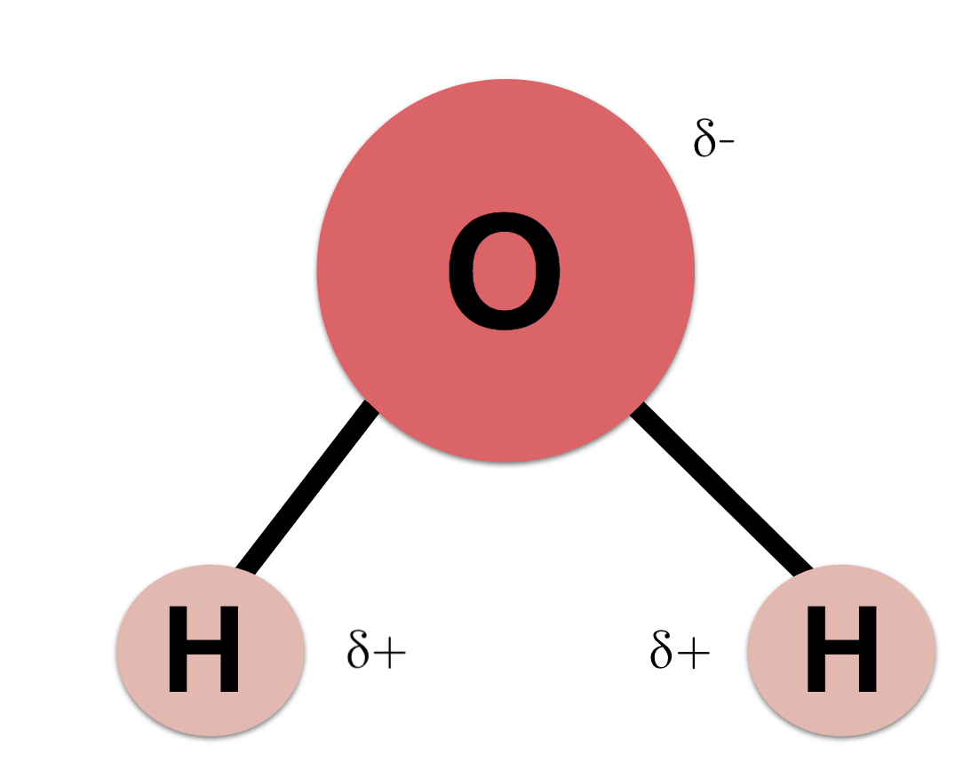
Complex Layouts
Complex Layouts are all around us!
Oxygen Atom
2 Hydrogen Atoms
Water Molecule

Slide 32
Complex Layouts
1 2 3 4 5 6
7
8
9
10
<Water> <Oxygen /> <Hydrogen /> <Hydrogen /> </Water>
// Water contains: // 2 Hydrogen Components // + 1 Oxygen Component
Oxygen Atom
2 Hydrogen Atoms
Water Molecule

Slide 33
Complex Layouts
1 2 3 4 5 6
7
8
9
10
<Menu> <MenuItems items={[...]} />
<Header text='BEST OF YOUTUBE' />
<MenuItems items={[...]} /> </Menu>

Slide 34
Complex Layouts
1 2 3 4 5 6
7
8
9
10
const MenuItemList = (props)=> { return ( <ul>
{props.items.map(item => ( <li>{item.label}</li> ))}
</ul> );
};
The MenuItemList component will render a <ul> tag (as seen on line 3) Inside of that <ul> tag we use the “map” method to loop over the “items” array (on line 4) to make an
<li> for each item in the array.

Slide 35
Complex Layouts
1 2 3 4 5 6
7
8
9
10
const Menu = (props) => {
return (<div>
{props.children}
</div>);
};
The Menu component will render a <div> that contains anything you put between the opening and closing tags when you use the Menu component.
Notes:
Teacher Notes:

Slide 36
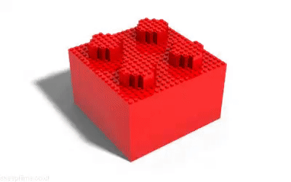
Let’s make a Complex Layout
Create two react components, then put them together to form a complex layout.
https://repl.it/@emuentes/33-Guided-Practice

Slide 39
Work Time
Create components
that take props for:
question text
some answer options for the question
* Use placeholder data for now
If you have time
Make answers clickable
Notes:
Teacher Notes:

Slide 40
Push up any changes!
git status
git add .
git commit -m "Your message here"
git push
Notes:
Teacher Notes:

Slide 41
Homework!!!
Closing (15m)
Complete HW 3.3 on Repl.it by Mon Jan 27th at 11:59pm
Notes:
Teacher Notes:

Slide 42
PM Announcements
Notes:
Teacher Notes:

Slide 43
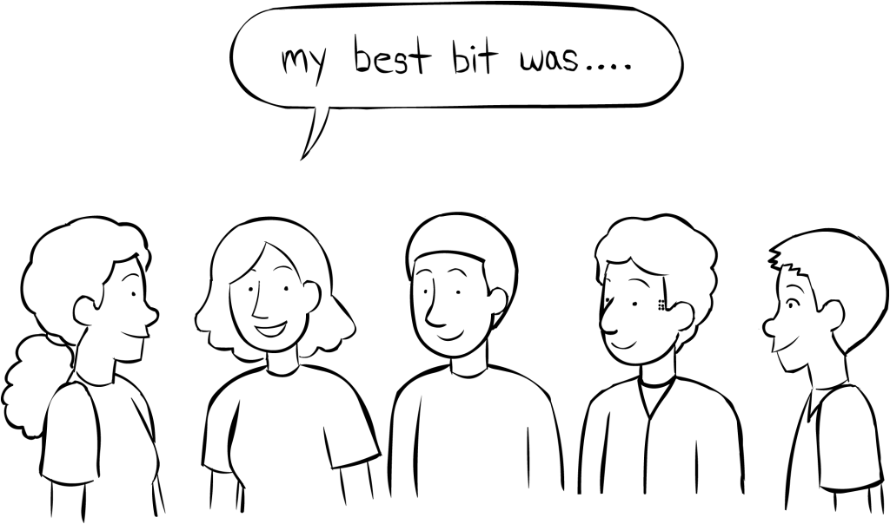
Stand Up
Did you reach your goals today?
If not, what steps do you need to take to ensure you reach today's goals before next class?
Notes:
Teacher Notes:

